Slide 4
Holography
Beam Splitter
Mirror)
Light from laser expanded with beam expander
Interference Pattern
(Hologram)
Object

Slide 5
Holography Reconstruction
Mirror)
Light from laser expanded with beam expander
Interference Pattern
(Hologram)
Reconstructed Image of Object

Slide 6
Diffraction of X-Rays by Crystals
X-rays are electromagnetic waves of very short wavelength
Max von Laue suggested that the regular array of atoms in a crystal could act as a three-dimensional diffraction grating for x-rays

Slide 8
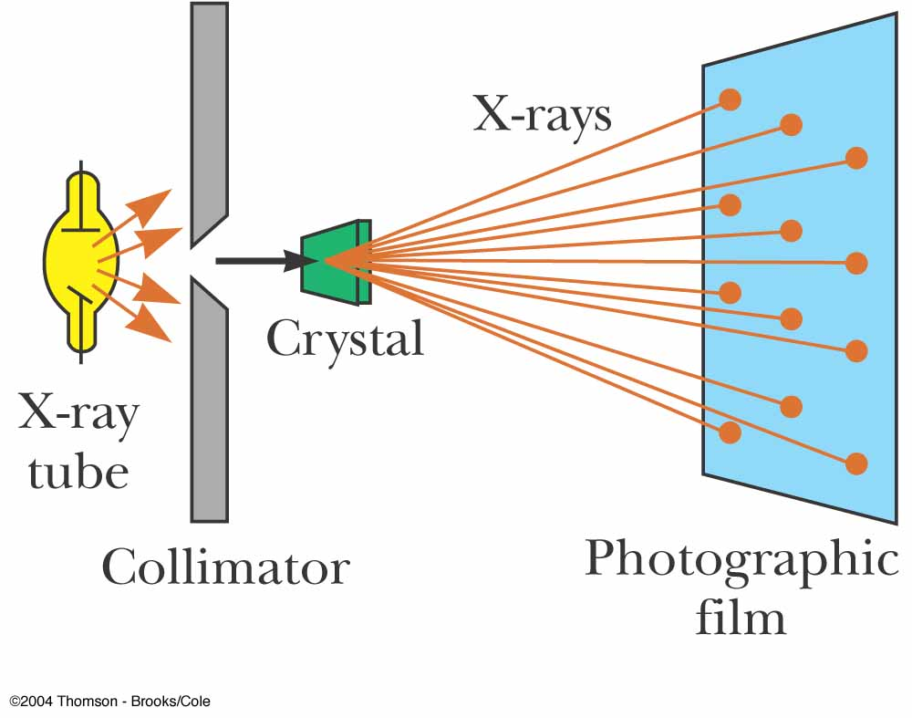
Diffraction of X-Rays by Crystals, Set-Up
A collimated beam of monochromatic x-rays is incident on a crystal
The diffracted beams are very intense in certain directions
This corresponds to constructive interference from waves reflected from layers of atoms in the crystal
The diffracted beams form an array of spots known as a Laue pattern

Slide 9
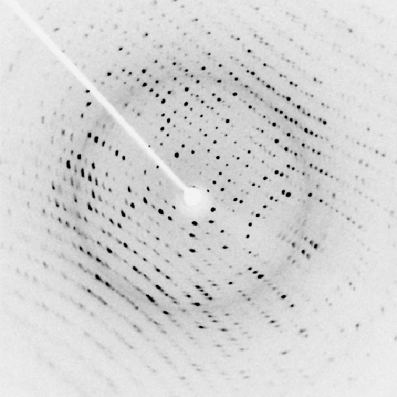

Slide 10
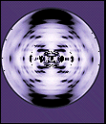

Slide 11
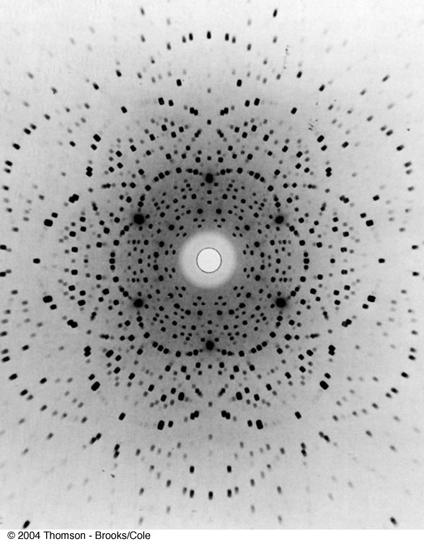
Laue Pattern for Beryl

Slide 12
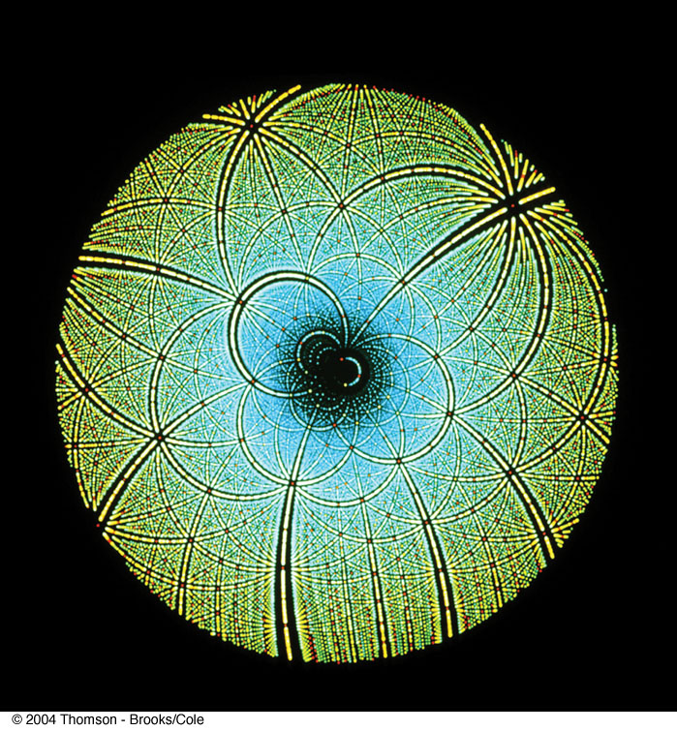
Laue Pattern for Rubisco

Slide 13
Question 223.12.3
I have a circular aperture illuminated by a laser. The aperture Diameter is E and the light that passes through the slit lands on the screen, a distance L away. If the aperture size increases, the size of the central spot will
Increase
Decrease
Stay the same
Impossible to tell

Slide 14
Question 223.12.4
I have a laser pointer with a wavelength of 632nm and a beam profile that is about half a millimeter across. I shine it through a circular aperture with a diameter of 1m. About how big is the central spot on a screen 10m away?
6.1683 x 10⁻⁶m
A few millimeters
Maybe a centimeter or two
About a meter

Slide 15
Question 223.13.0.6
I have radar waves (λ = 3.2cm) that illuminate a circular aperture with diameter of 2mm. Will the wave nature of light be important?
Yes
No
Maybe

Slide 16
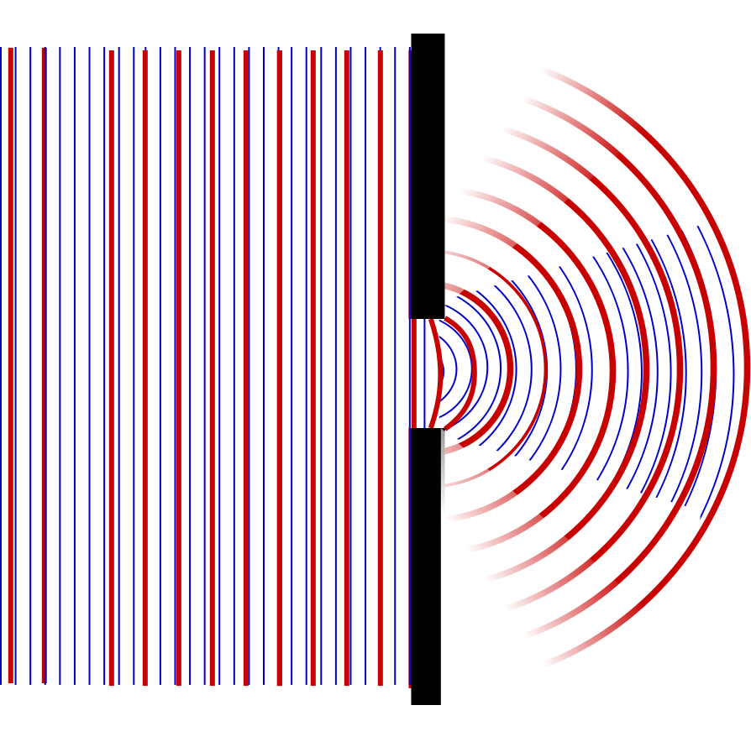

Slide 17
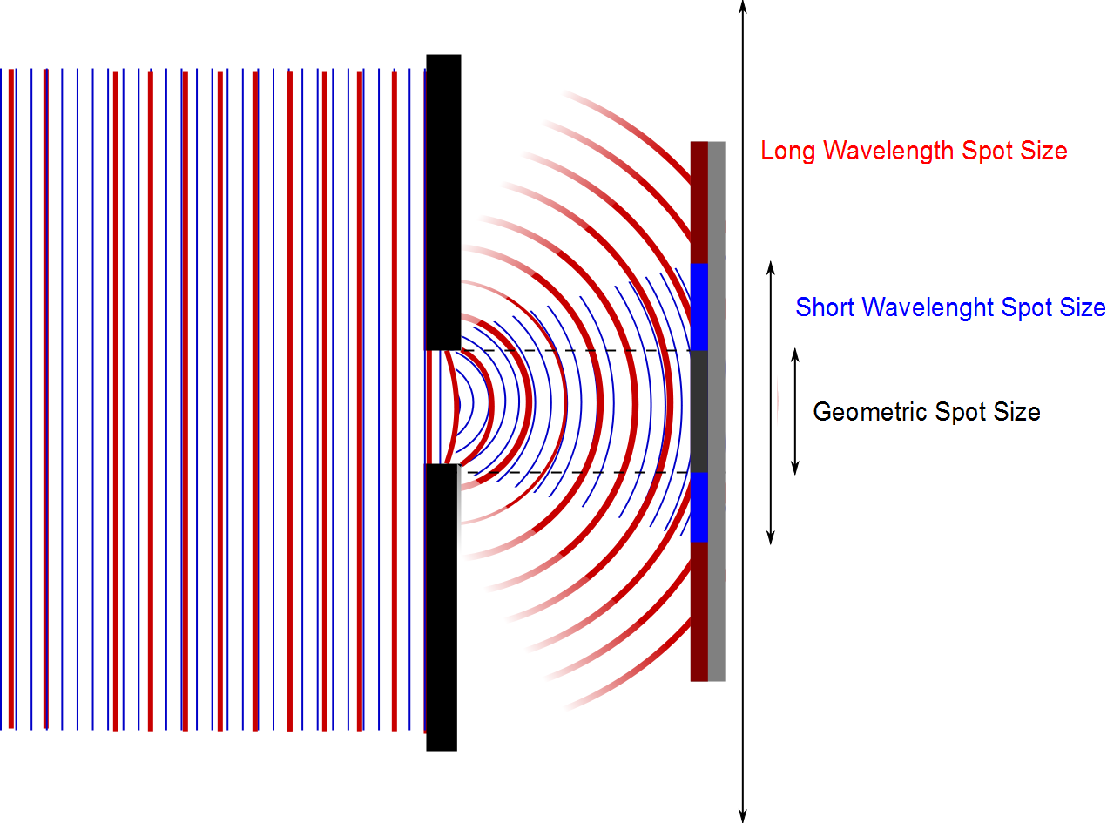

Slide 18
Question 223.13.0.5
I have radar waves (λ = 3.2cm) that illuminate a circular aperture with diameter of 2m. Will the wave nature of light be important?
Yes
No
Maybe

Slide 19
Question 223.13.0.7
I have radar waves (λ = 3.2cm) that illuminate a circular aperture with diameter of 3.2cm. Will the wave nature of light be important?
Yes
No
Take another physics class to find out

Slide 20
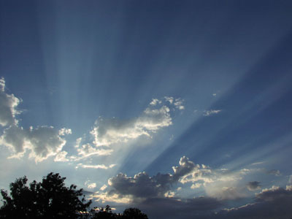
Question 223.13.1
You are in the western US and you observe a dramatic sunset. The Sun is descending through a bank of clouds and you see light and dark bands . What is causing these?
Constructive and Destructive Interference from the light traveling through small slits in the mountains
Constructive and Destructive Interference from the light traveling through small openings in the clouds
The dark bands are cloud or mountain shadows
Crepuscular rays: Image public domain http://commons.wikimedia.org/wiki/File:Crepuscular_rays.jpg

Slide 21
Question 223.13.1.5
If I take two light bulbs near each other, will I observe interference where the light from the bulbs meet?
Yes
No

Slide 22
Question 223.13.2
Will light from two sources that starts in phase necessarily stay in phase?
Yes, if the initial phase is the same, the light will stay in phase
No, the light might have different wavelengths, which will cause the phase to diverge
No, The light might take different paths, which would cause a relative phase

Slide 23
Question 123.13.3
Which of the following would likely be a coherent source?
Laser
Light bulb
Glow stick
Radio transmission
Black body emission

Slide 24


